Slide 1
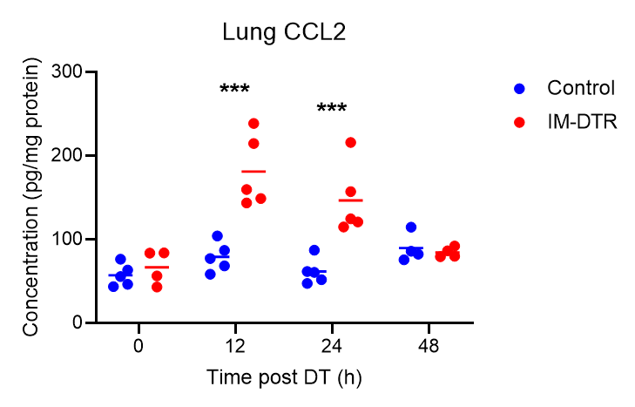
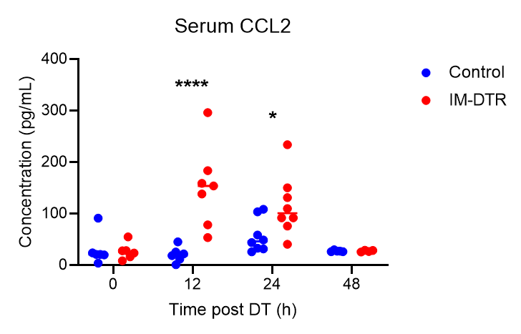
a
b
Add “IM-DTR”, precisely state the read-outs here on the timeline according to what we show in the figure
We need % of bulk IM added to the plots as well.
c
d
Littermate controls
IM-DTR
Colors inverted as compared to c; change colors anyway
Same terminology as before for naming cell populations; change colors.
IM-DTR
Littermate controls
e
f
Experimental set up fo BM Ly6C+ monocyte transfer
g
Mixed BM chimeras data showing that IM refilling is NR4A1-independent – and that the cells in blue above do not represent patrolling monocytes but rather classical monocytes first losing Ly6C expression and differentiating into IM. Will also be consolidated by the scRNAseq model.
Terminology, etc consistent with the rest of the figures, let’s discuss the colors, and also add statistics here (lt’s discuss what to test).
h
i
Bulk RNA-seq data on native and repopulated IM subsets and AM showing that they are basically transcriptionally similar: show PCA / hierarchical clustering and heatmap? and in line with that we could also show that in line with that, rep IM can be re-depleted by DT again (panel i).

